Slide 1
Wrist Ligaments
Timothy W. Deyer, MD
Musculoskeletal and Interventional Radiology
East River Medical Imaging
Clinical Instructor
New York Presbyterian Hospital

Slide 2
A copy of the presentation can be found at:
eastriverimaging.com/blog/lenox-hill-wrist/

Slide 3
Wrist Ligaments
Intrinsic
Attach solely to carpal bones in wrist
Extrinsic
Additional attachments to the forearm, retinacula, or tendon sheaths
Location
Volar
Dorsal

Slide 4
Imaging Modalities
X-ray
Ultrasound
CT
MRI

Slide 5
X-ray – Wrist
Views
PA/Lat/Oblique
Evaluate carpal arcs
Broken arc = ligament or osseous injury

Slide 6
X-ray – SL Ligament Tear
Widening of SL interval
Views
Clenched fist
AP not PA
Suppinated
Ulnar deviation
Clenched Pencil
May show dorsal intercalated instability

Slide 7
Clenched Fist
Normal
Widened

Slide 8
X-ray – LT Ligament Tear
Often normal
May show volar intercalated instability

Slide 9
Ultrasound
Not a primary imaging modality
Can see dorsal SL and LT ligaments

Slide 10
CT – Wrist Ligaments
Must be an arthrogram
Identify contrast traversing ligament
Ligament injury also inferred by contrast extension between compartments
Best for evaluating intrinsic ligaments
Utility
Evaluation of concomitant bony injury
If MRI contraindicated
95% sensitive, 96% specific for SL ligament tear

Slide 11
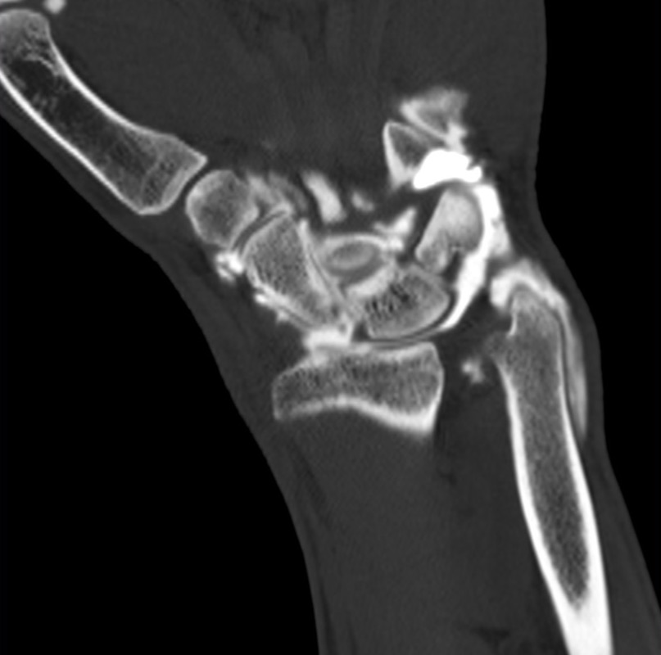
CT Arthrogram - Volar
Mid Carpal Extension
Intact LT
Torn Volar SL

Slide 12
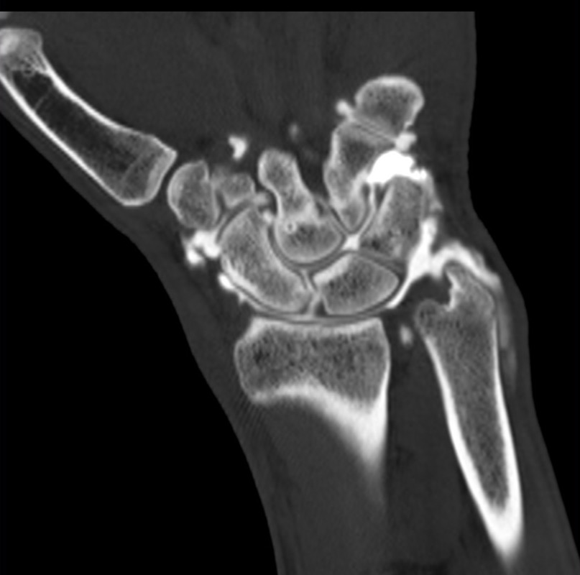
CT Arthrogram - Central
Mid Carpal Extension
Intact LT
Torn Membranous SL

Slide 13
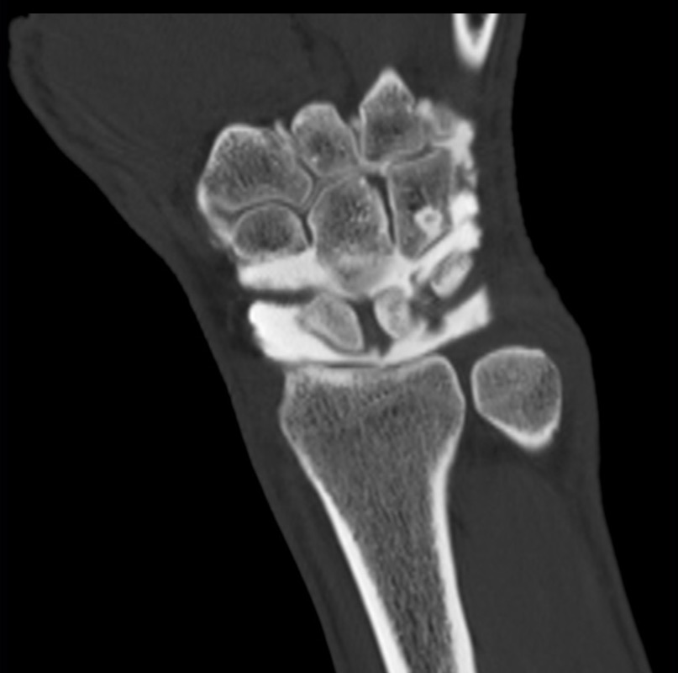
CT Arthrogram - Dorsal
Intact LT
Intact Dorsal SL

Slide 14
Wrist MRI Imaging
Need
High spatial resolution
High SNR
High contrast to noise

Slide 15
Wrist MRI Imaging
Limit artifacts
Chemical shift
Magic angle
Motion
Intrinsic
Extrinsic
Wrap
Partial volume

Slide 16
MRI Sequences for Ligament Imaging
Correct protocol imperitive
FSE - Proton Density
1-2 mm thick
2D/3D GRE - Proton density weighted
1-2 mm thick
Fat saturated or inversion recovery

Slide 17
1.5 T Extremity MRI

Slide 18
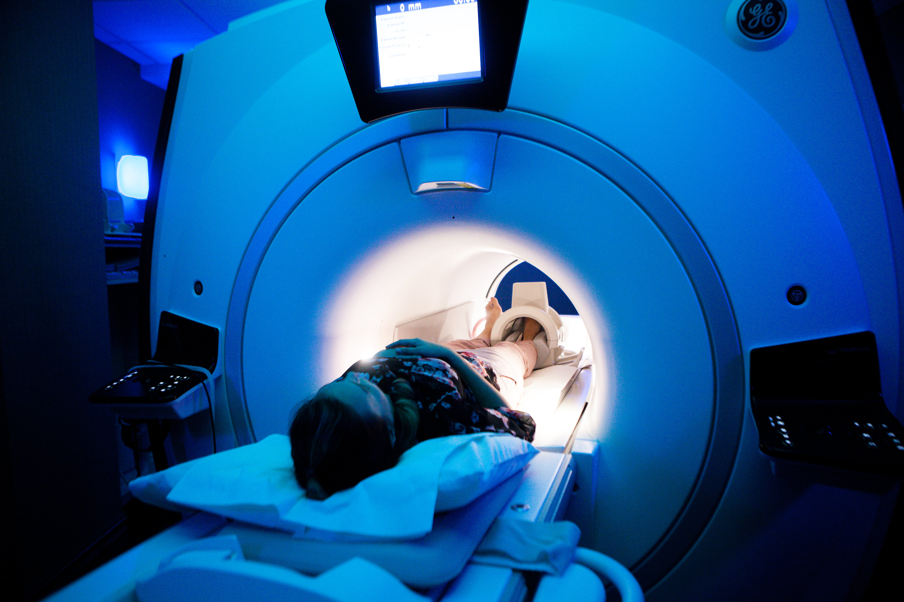
3T Wide Bore

Slide 19
Spatial Resolution
Burns et Al Radiographics

Slide 20
SNR
Burns et Al Radiographics

Slide 21
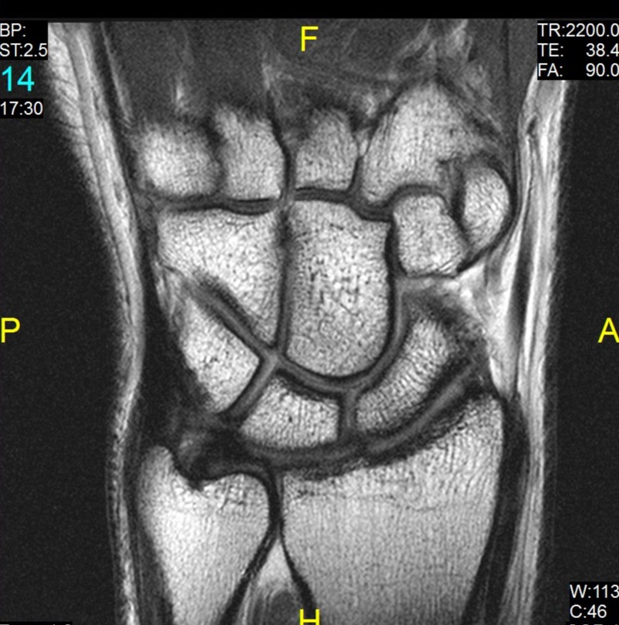
Sequence Selection

Slide 22
MRI of Intrinsic Ligaments of the Wrist
Scapholunate ligament
Lunotriquetral ligament

Slide 23
Intrinsic Ligaments
MR diagnosis
Sensitivity 59%
Specificity 70%
Arthrogram improves
Sensitivity 68%
Specificity 87%
Why?
Low resolution study – contrast and spatial
Normal variants
Why not use arthrography
Invasive
Limits evaluation of other structures
Moser et al. American Journal of Roentgenology. 2007;188: 1278-1286
Notes:
Low sensitivity due to
spatial resolution
contrast resolution
artifacts – chemical shift

Slide 24
Scapholunate Ligament - Shape
Dorsal and volar band like – true ligaments
Membranous
Fibrocartilage
Band like dorsally
Triangular centrally
Trapezoidal volarly
Burns et Al Radiographics

Slide 25
Scapholunate Ligament – Signal Intensity
Volar
Low signal (though slightly higher than dorsal)
Membranous
Heterogeneous signal
Dorsal
Low signal intensity

Slide 26
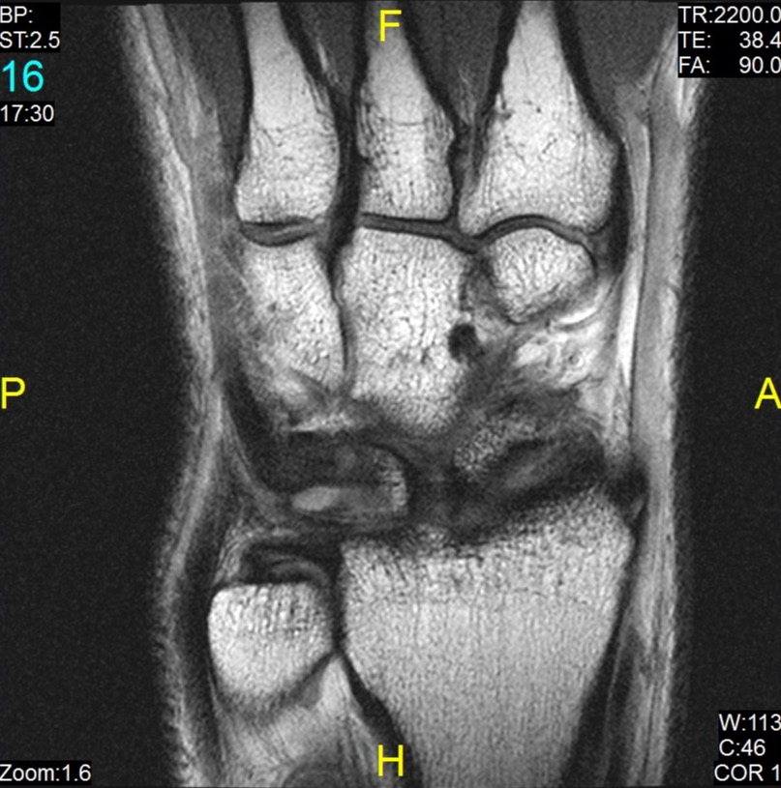
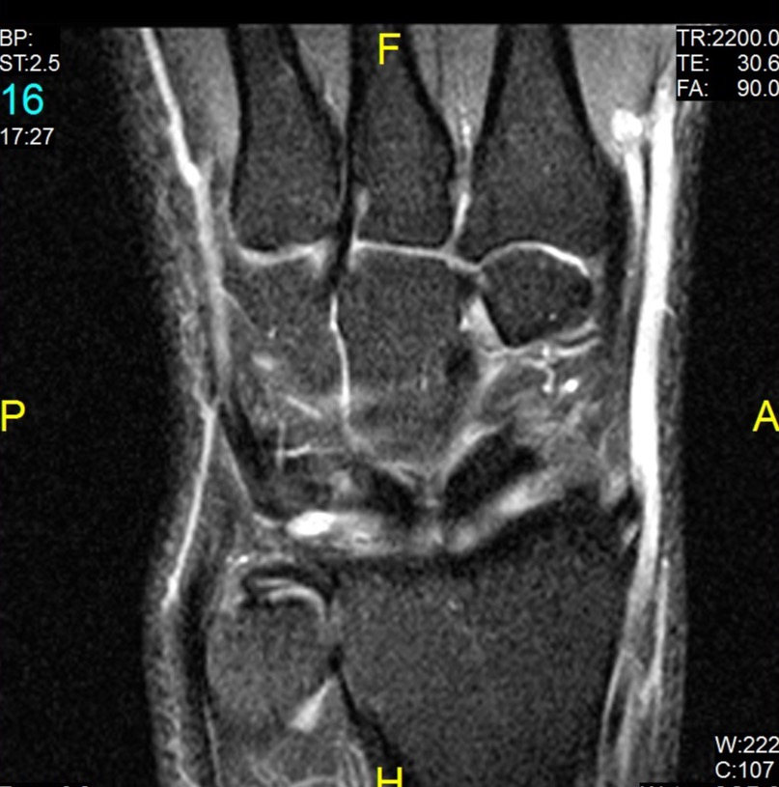
Scapholunate Ligament - Volar

Slide 27
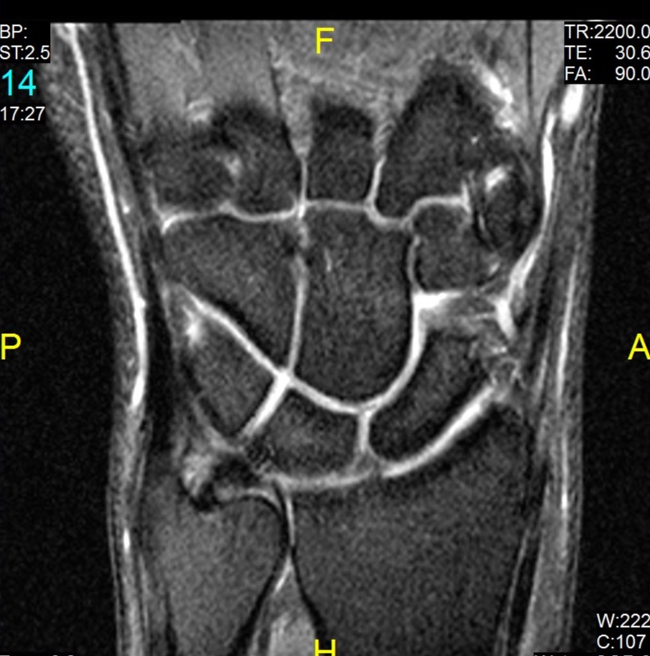
Scapholunate Ligament - Membranous

Slide 28
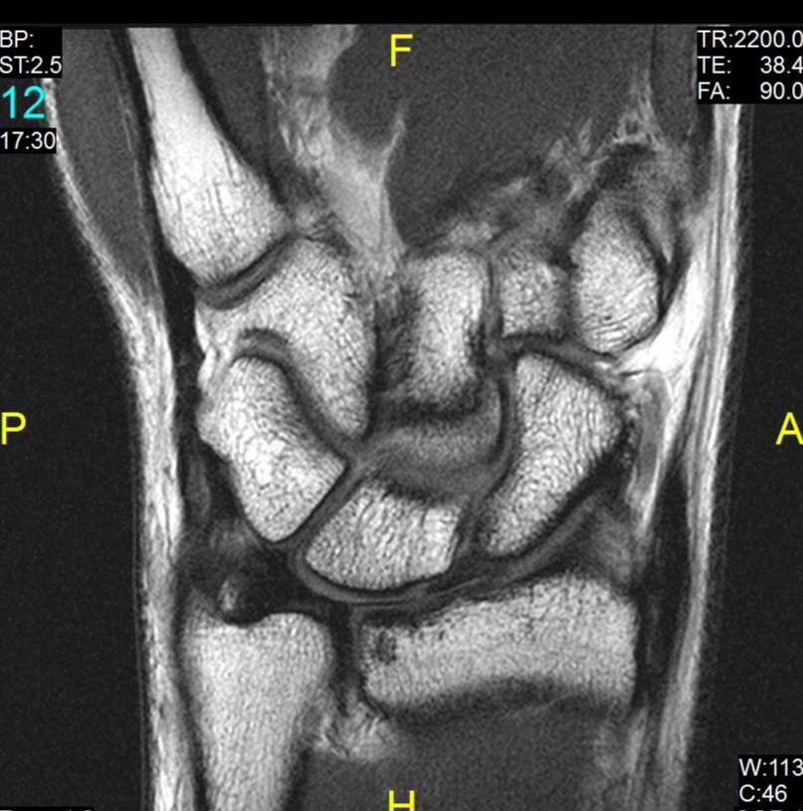
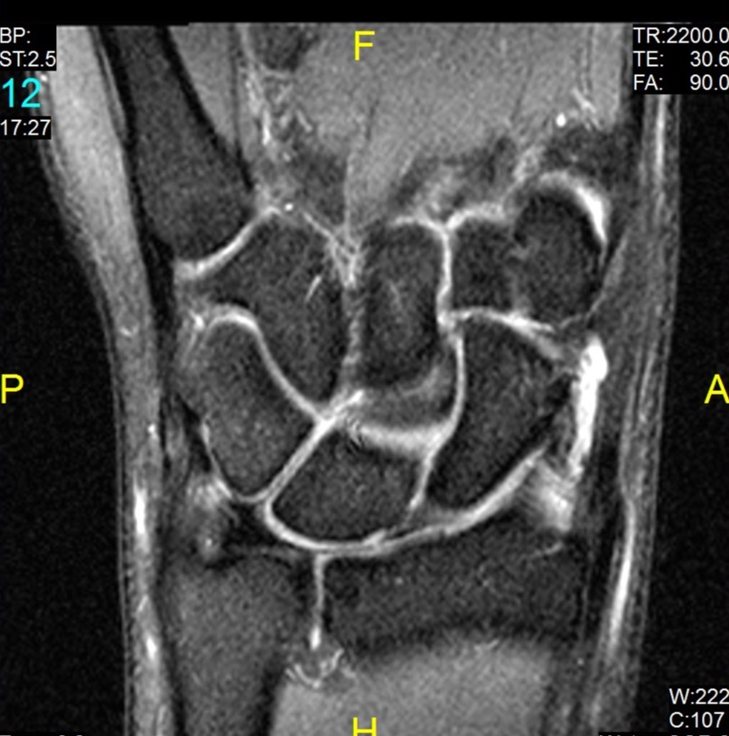
Scapholunate Ligament - Membranous

Slide 29
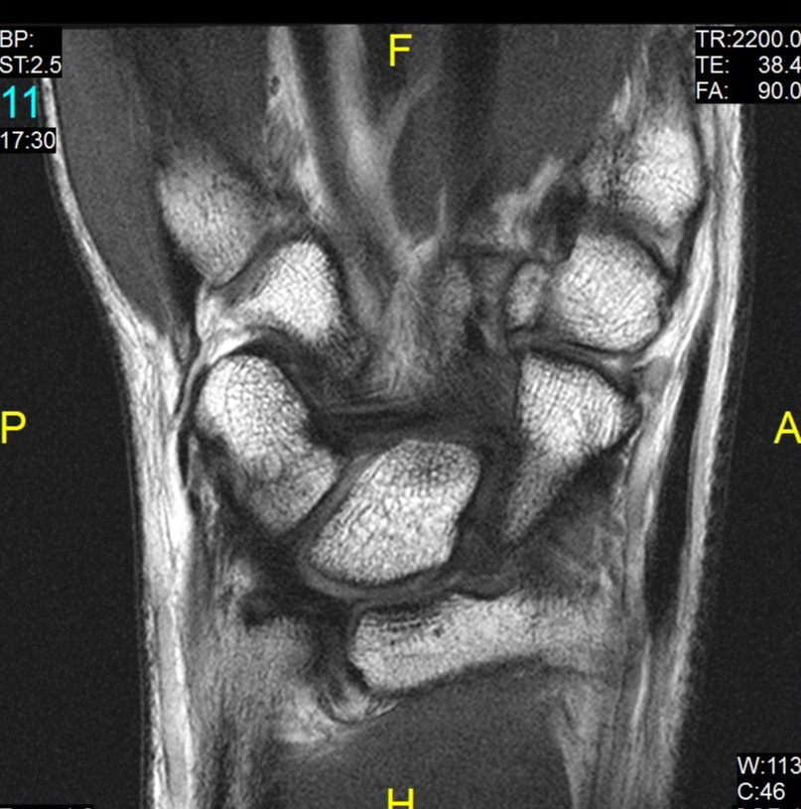
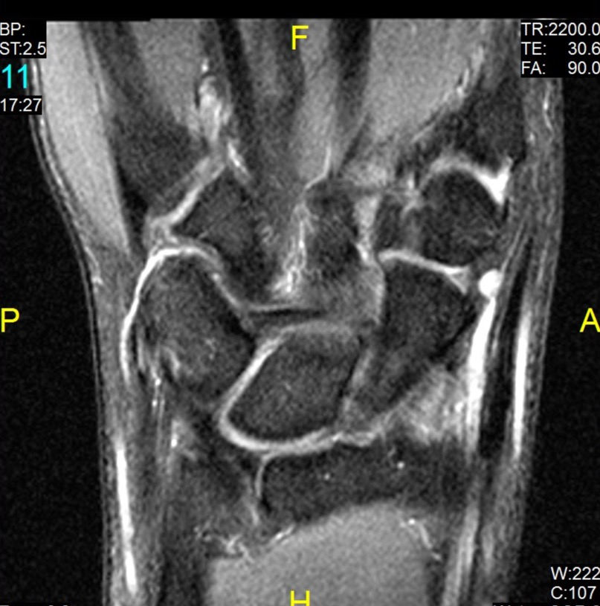
Scapholunate Ligament - Dorsal

Slide 30
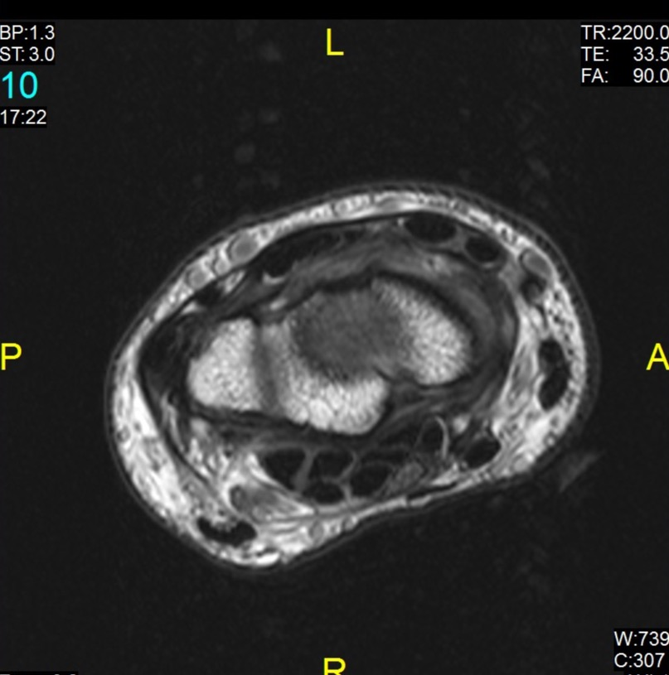
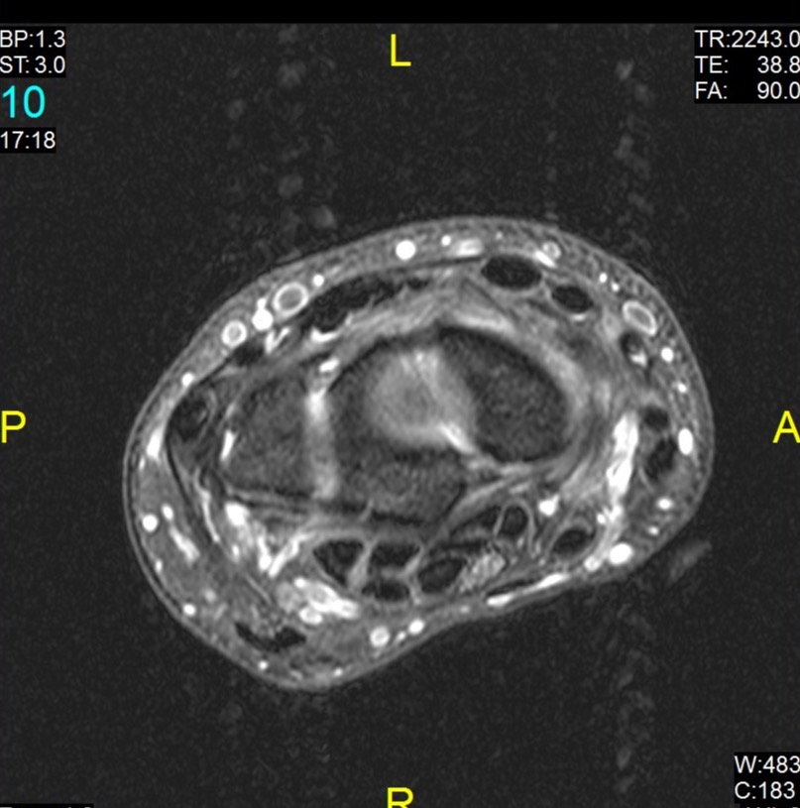
Scapholunate Ligament - Volar and Dorsal

Slide 31
Scapholunate Ligament - Pathology
Sprain
Hyperintense
Thickened
Tear
Findings
Abnormal morphology
Traversing fluid/contrast
Widening
Tear of membranous component often seen in asymptomatic patients
Often associated with extrinsic ligament injury

Slide 32
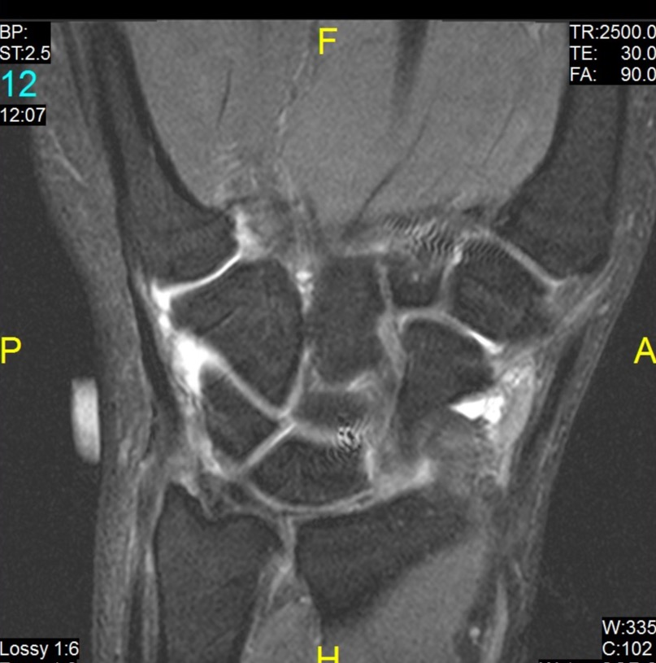
SL Tear – Arthrogram Volar

Slide 33
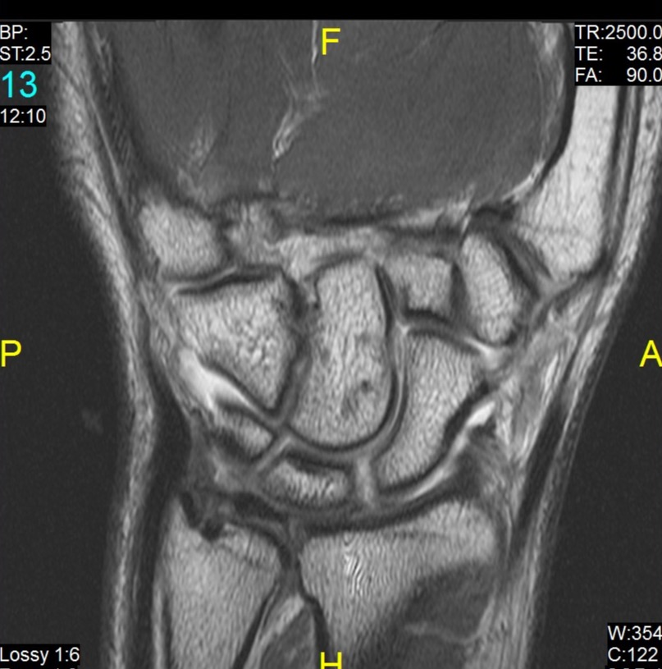
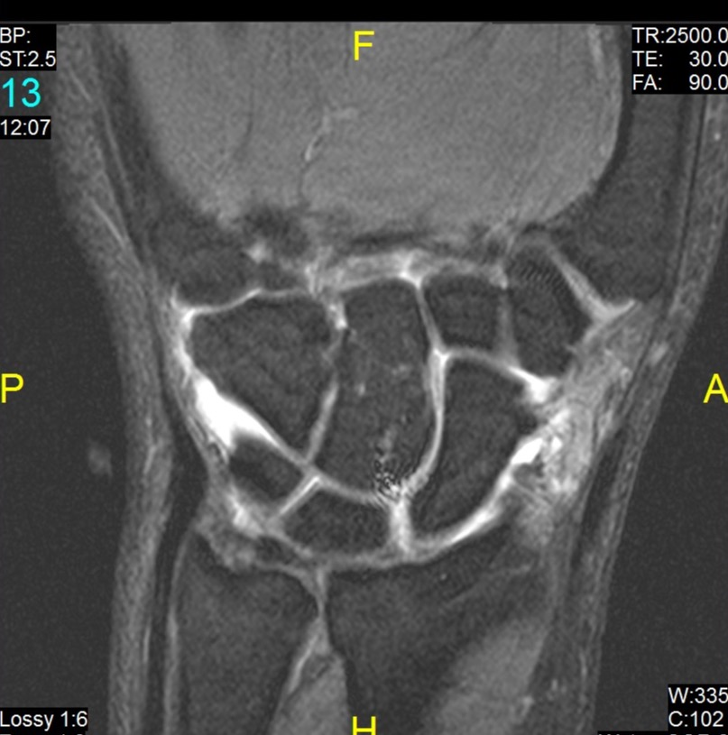
SL Tear – Arthrogram Membranous

Slide 34
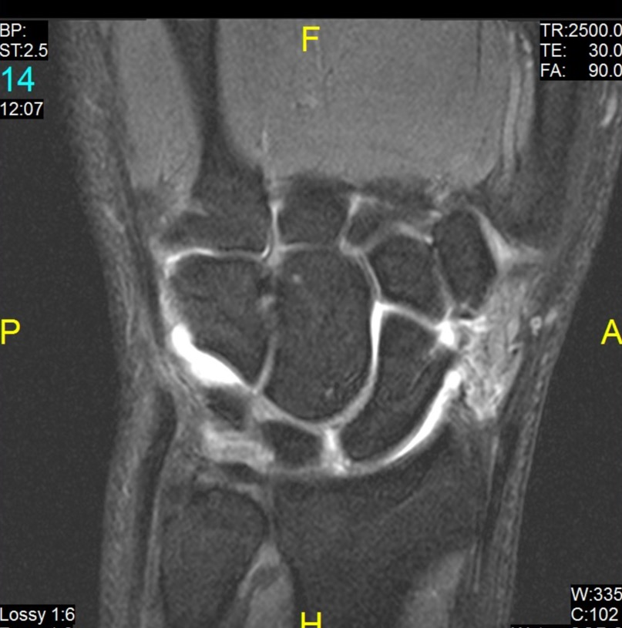
SL Tear – Arthrogram Dorsal

Slide 35
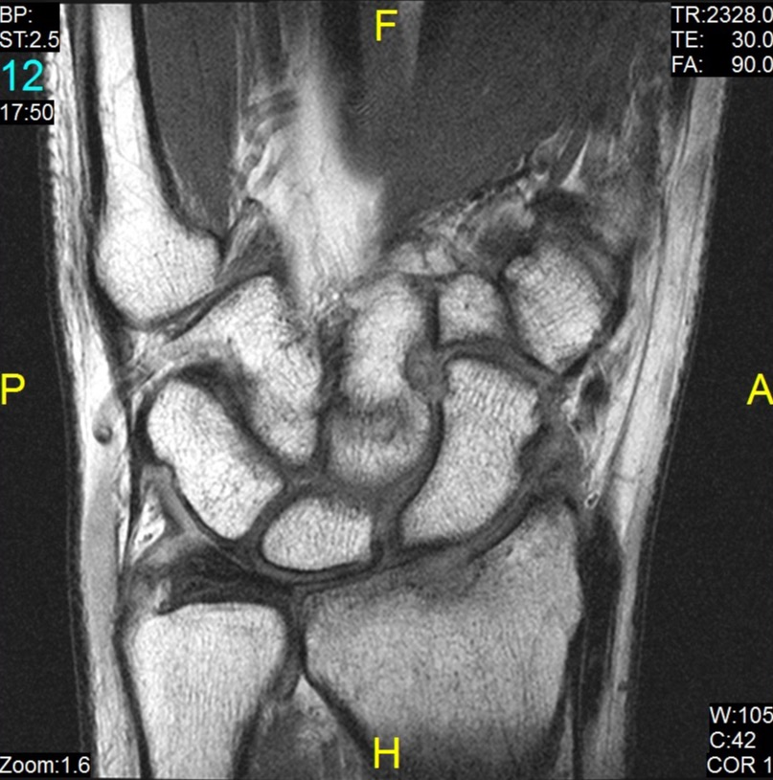
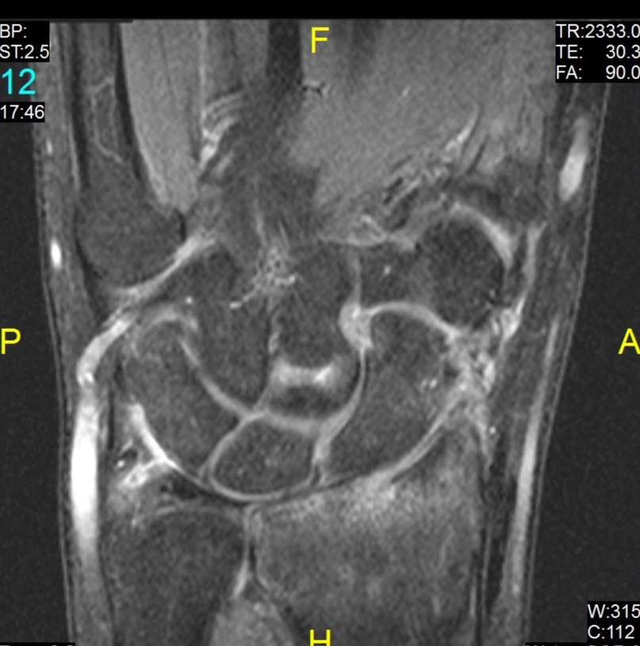
SL Tear - Volar

Slide 36
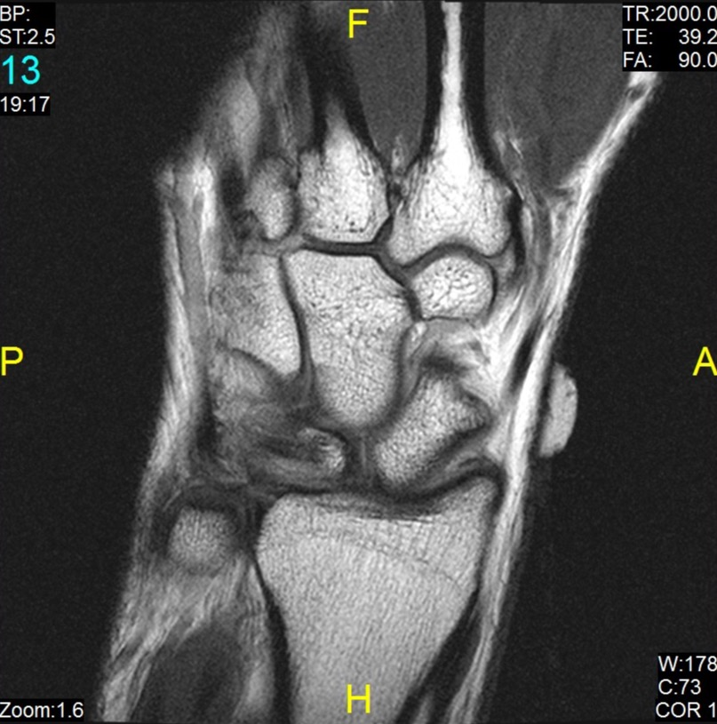
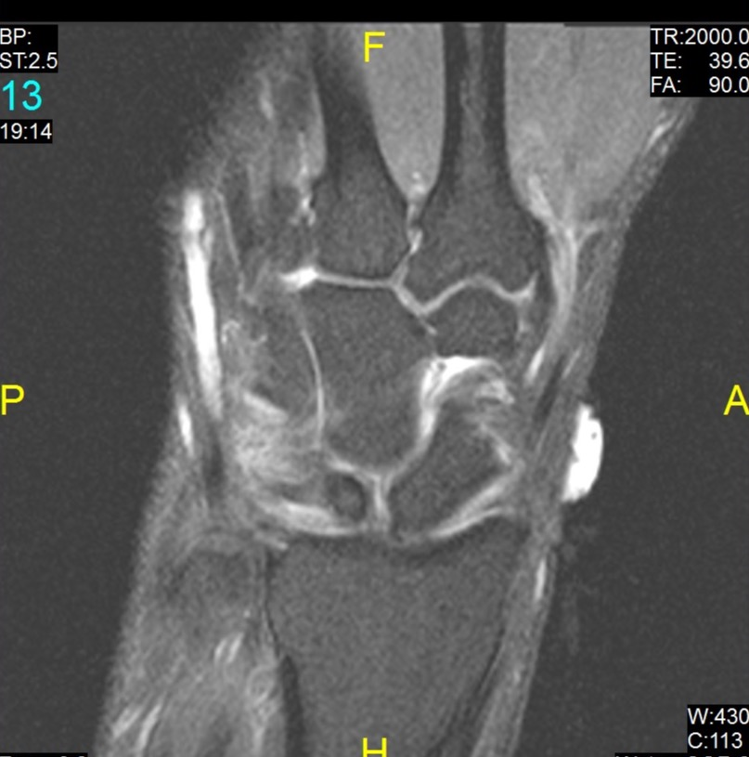
SL Tear - Dorsal

Slide 37
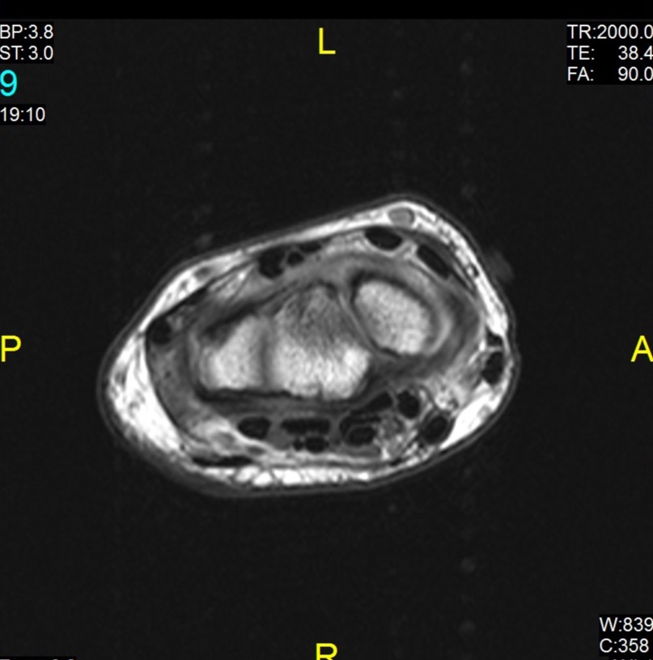
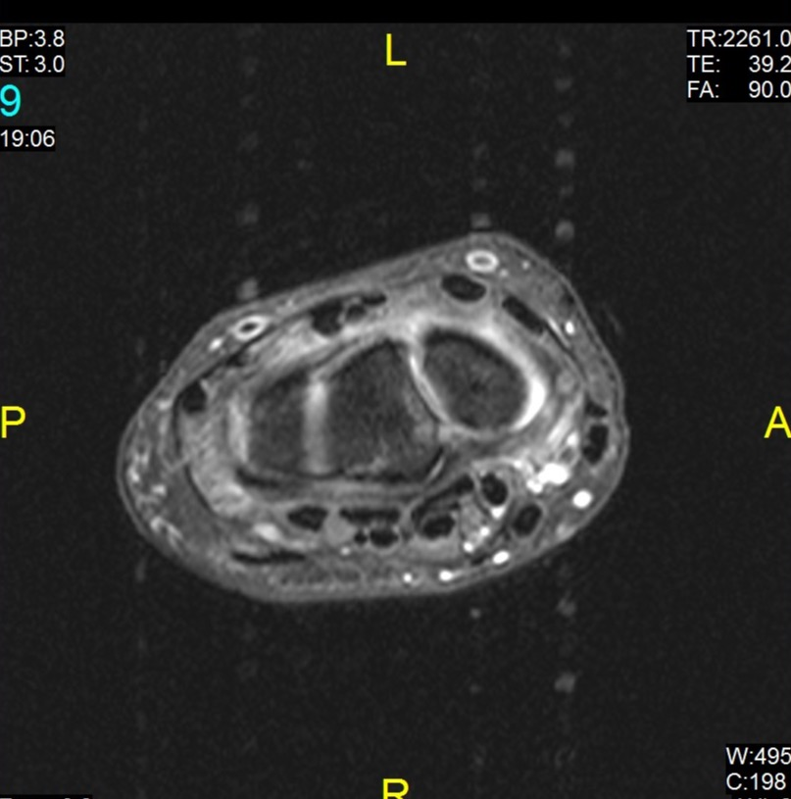
SL Tear - Dorsal

Slide 38
Lunotriquetral Ligament
V-Shape
Dorsal and Volar best seen axially
Membranous seen best on coronal
Varies in shape
Signal similar to SL
34% 45% 21%

Slide 39
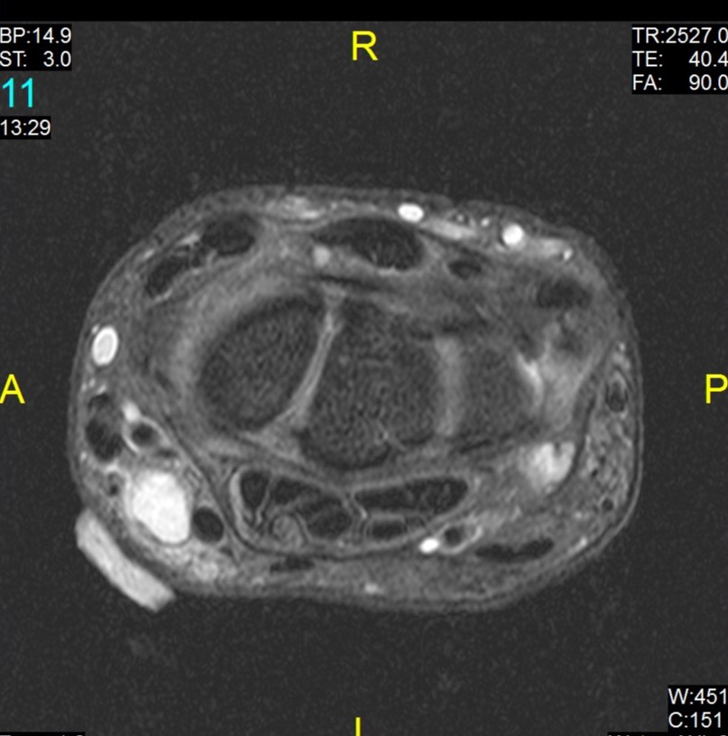
Lunotriquetral Ligament

Slide 40
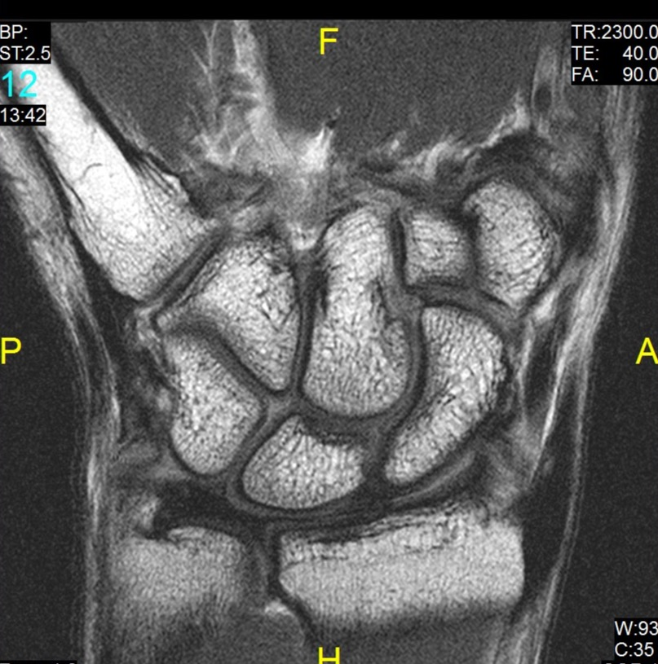
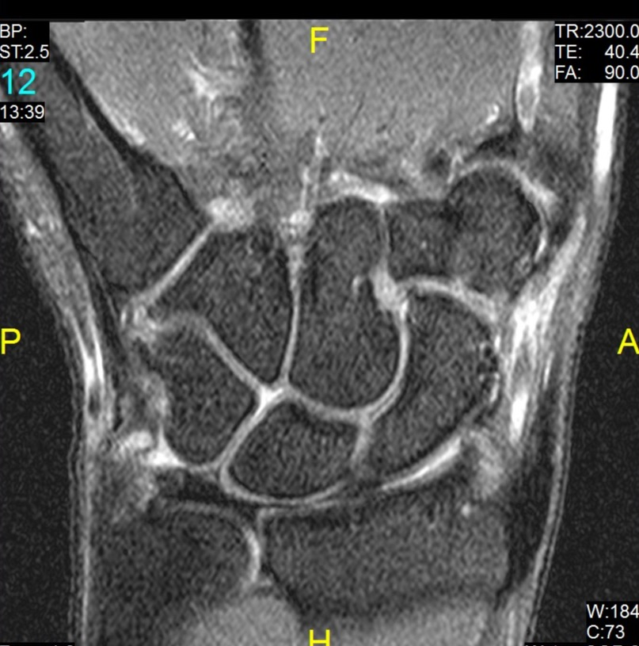
Lunotriquetral Ligament

Slide 41
Extrinsic Ligaments
Triangular Fibrocartilage Complex
Volar
Dorsal

Slide 42
Triangular Fibrocartilage Complex
Components (terminology variable)
Triangular fibrocartilage
Articular disk
Dorsal and radioulnar ligaments
Meniscal homologue
Ulnar ligaments - collateral, ulnolunate, ulnotriquetral, triangular ligaments
ECU tendon sheath

Slide 43
Normal Appearance TFCC
Articular disk
Uniform low signal
Thins with pronation
Radioulnar ligaments
Band like
Uniform low signal
Triangular ligament
Laminated
Proximal Lamina (Foveal)
Distal Lamina (Styloid)
Lamina separated by loose connective tissue - ligamentum subcruentum
Notes:
Most important components for MRI evaluation

Slide 44
Normal Appearance TFC
Meniscal homologue
Uniform low signal
Ulnocarpal ligaments
Small structures
Not well seen

Slide 45
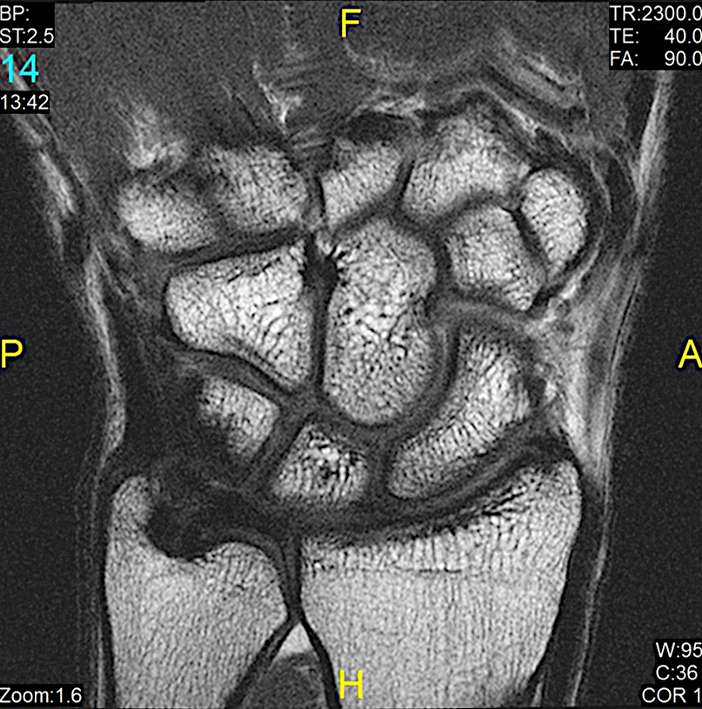
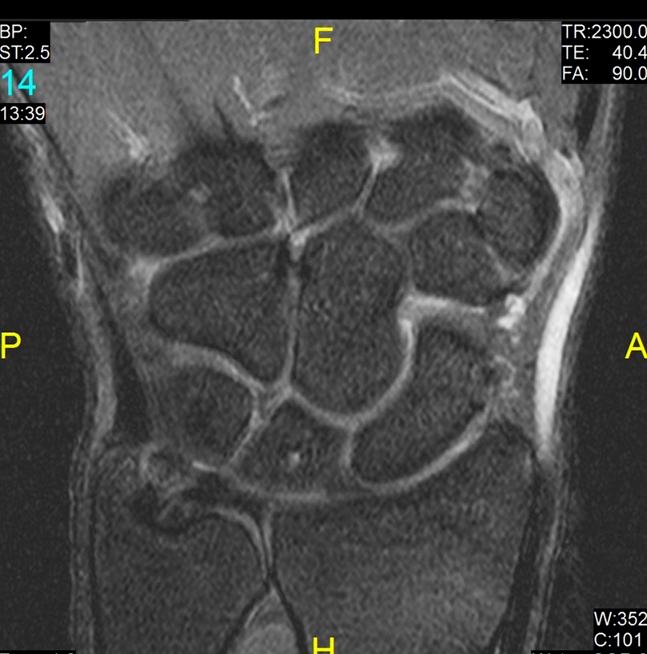
Normal Appearance TFCC
Articular disk
Articular disk

Slide 46
Normal Appearance TFC
Triangular Ligament
Triangular Ligament

Slide 47
Normal Appearance TFC
Distal
Lamina
Proximal
Lamina
Distal
Lamina
Proximal
Lamina

Slide 48
Normal Appearance TFC
Ligamentum Subcruentum
Ligamentum Subcruentum

Slide 49
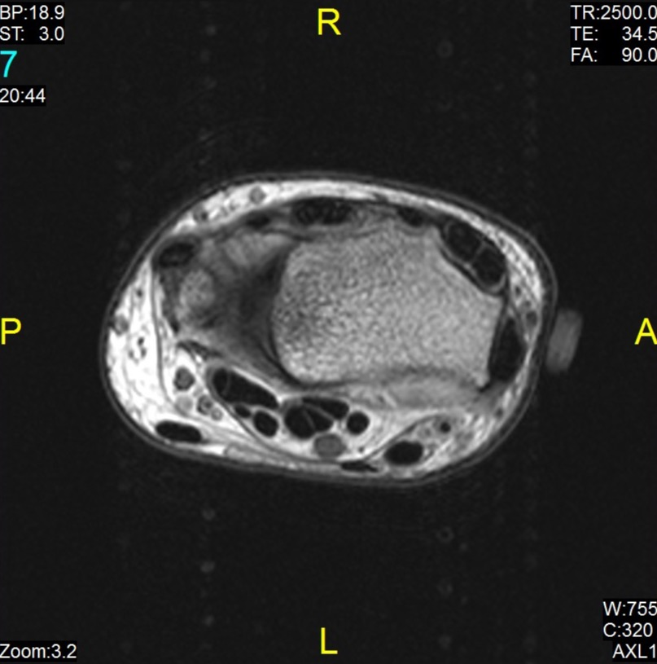
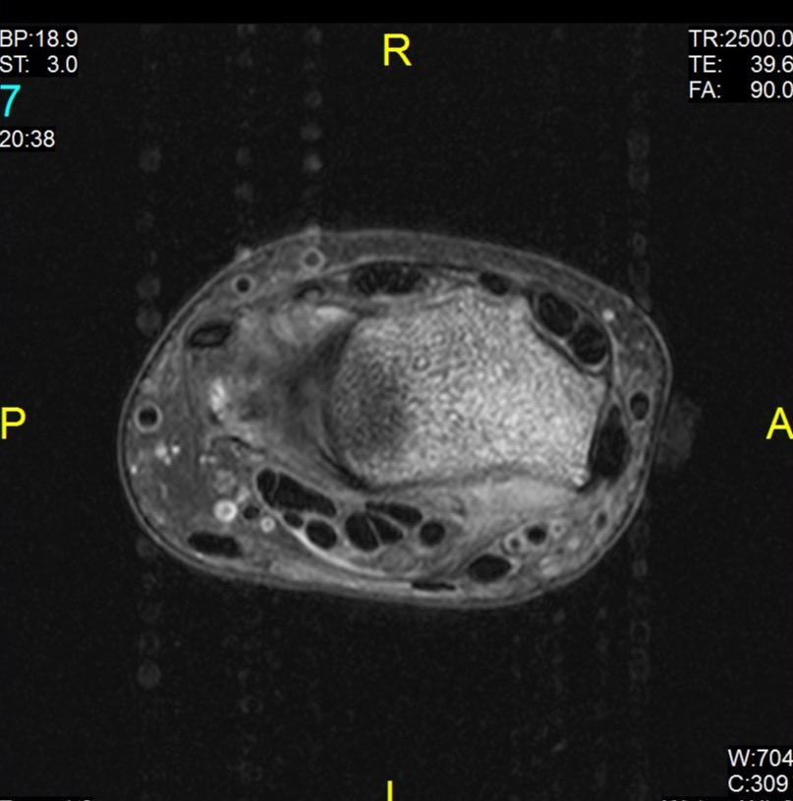
Normal Appearance TFC
Dorsal Radioulnar
Dorsal Radioulnar

Slide 50
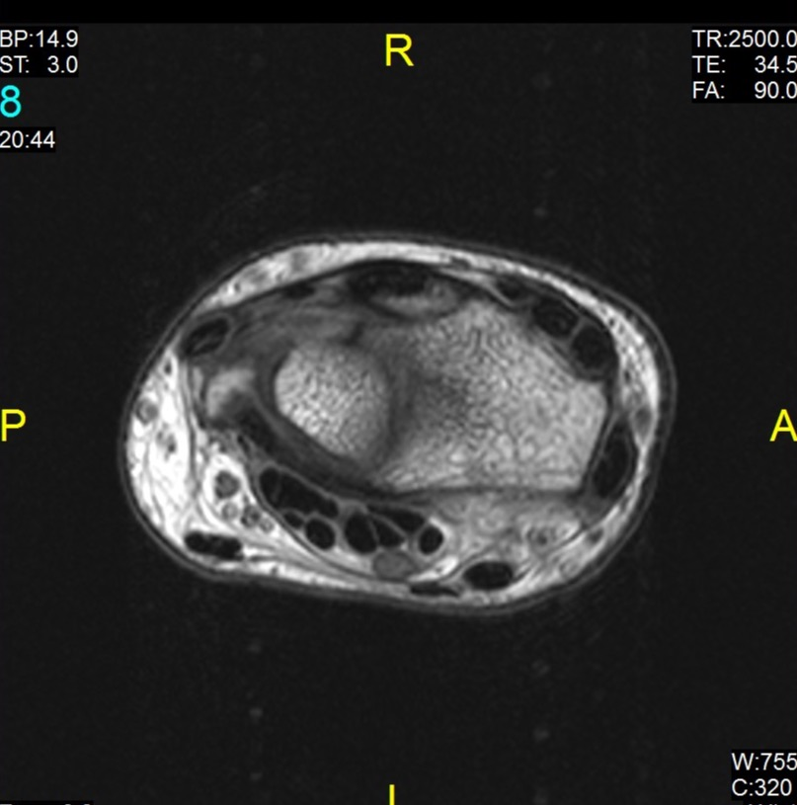
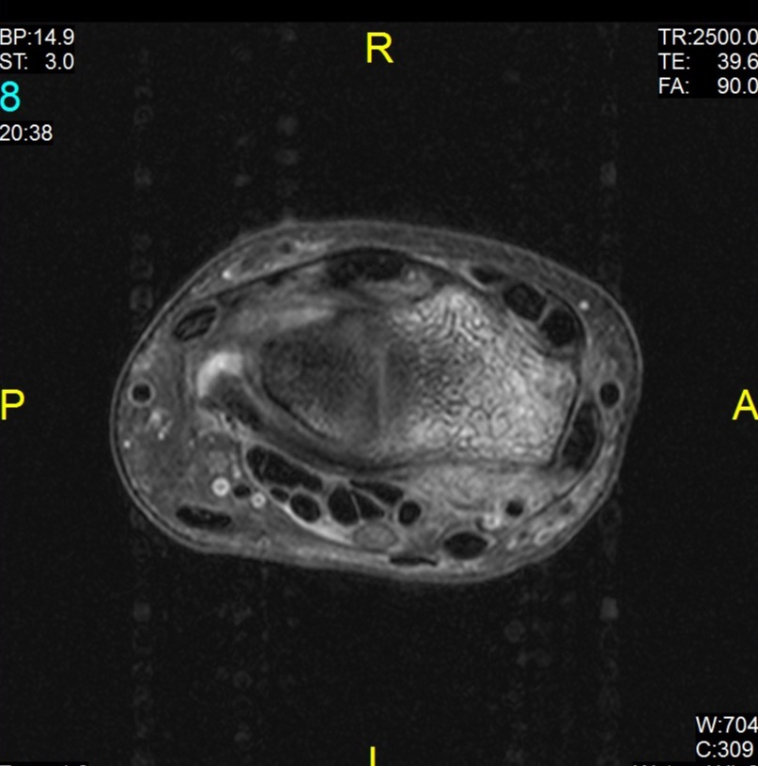
Normal Appearance TFC
Volar Radioulnar
Volar Radioulnar

Slide 51
Normal Appearance TFC
Ulnotriquetral Lig
Ulnotriquetral Lig

Slide 52
Normal Appearance TFC
Meniscal Homologue
Meniscal Homologue

Slide 53
Normal Appearance TFC
ECU Tendon
Sheath
ECU Tendon
Sheath

Slide 54
Normal Signal at TFC Attachments
Proximal lamina (foveal attachment)
High signal loose connective tissue
Distal lamina (styloid attachment)
May have intermediate signal due to hyaline cartilage at tip of ulnar styloid
Radial attachment
Intermediate signal hyaline cartilage centrally

Slide 55
Normal Appearance Radial and Ulnar Attachments

Slide 56
TFCC Pathology
Degeneration
Intra-substance high signal
Perforation of the disc
Focal traversing high signal
Incidence in asymptomatic individuals increases with age
Tear
Ulnar or radial attachments
Notes:
Must correlate perforation clinically – likely not pathologic

Slide 57
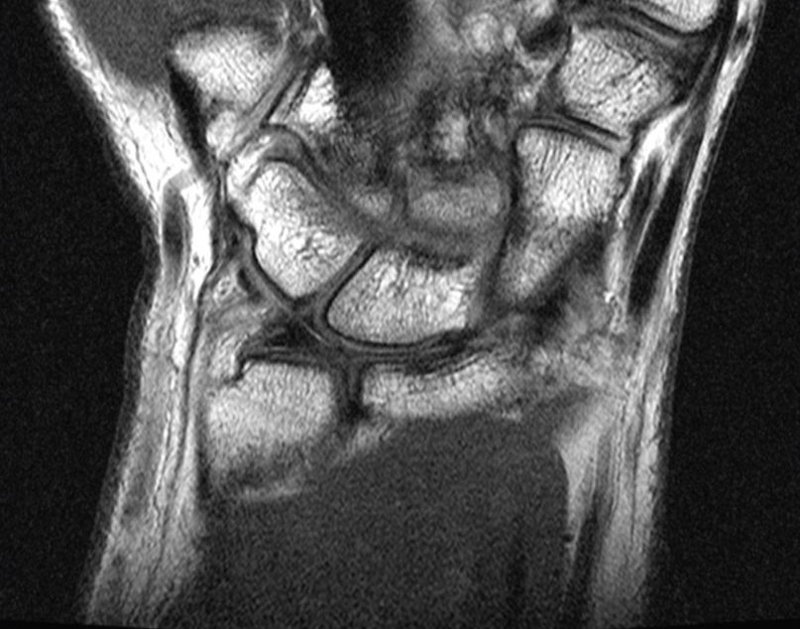
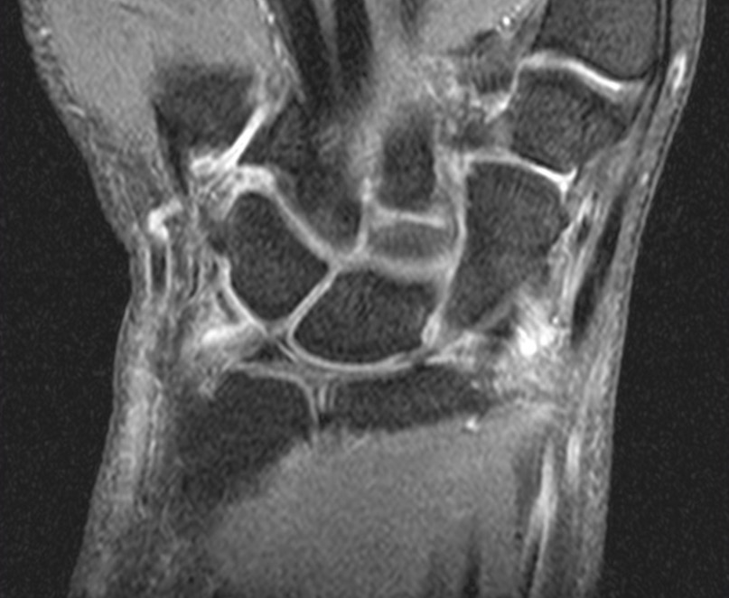
TFCC Disk Degeneration
Notes:
Like meniscal degeneration – does not reach the articular surface

Slide 58
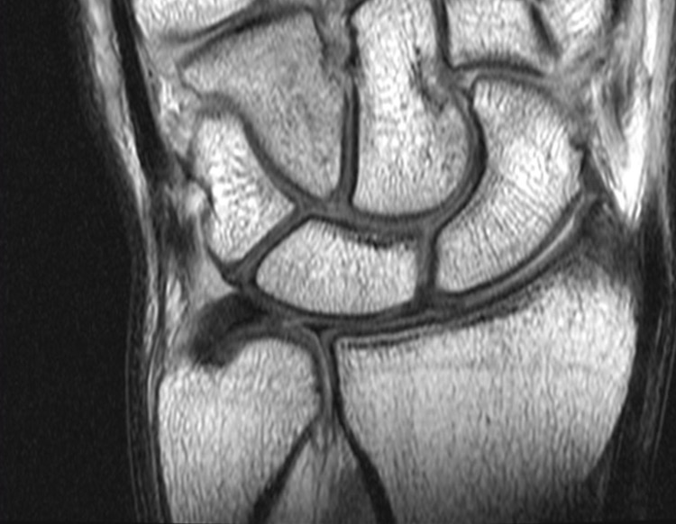
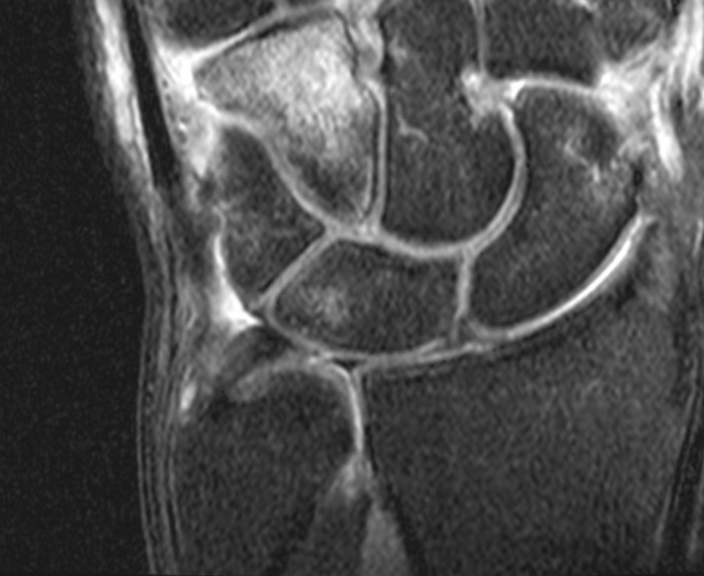
TFC - Disk Perforation

Slide 59
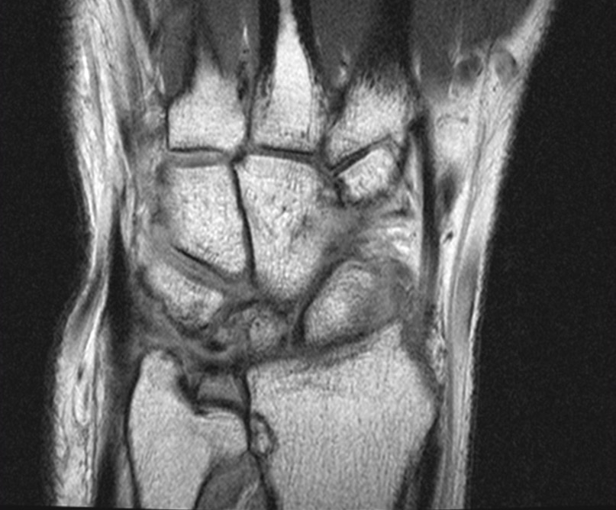
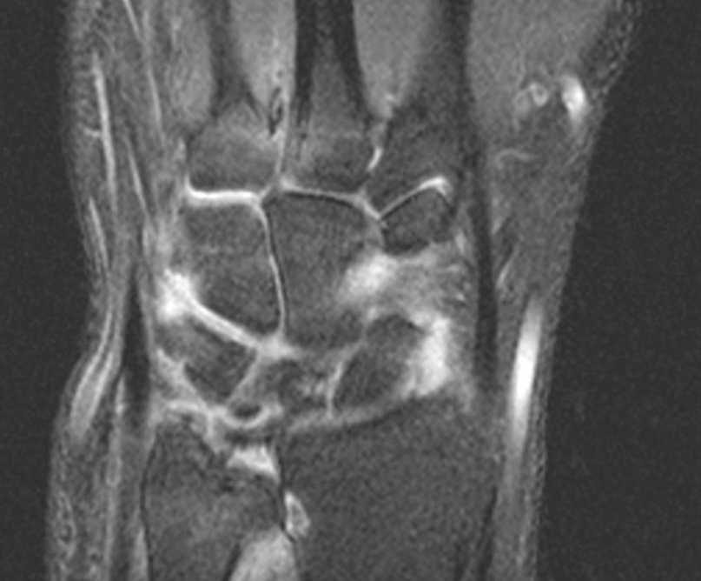
Peripheral Tear of the TFCC

Slide 60
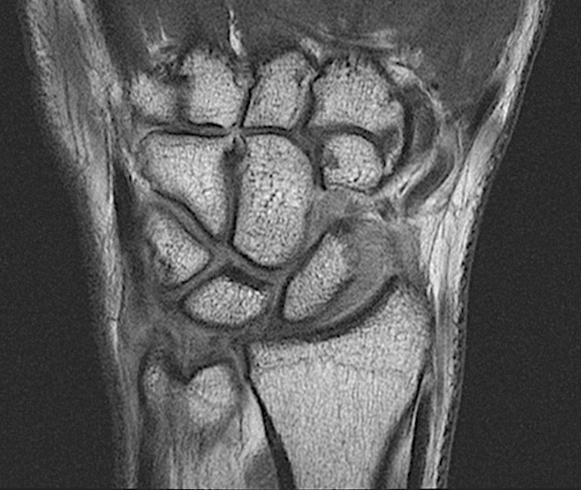
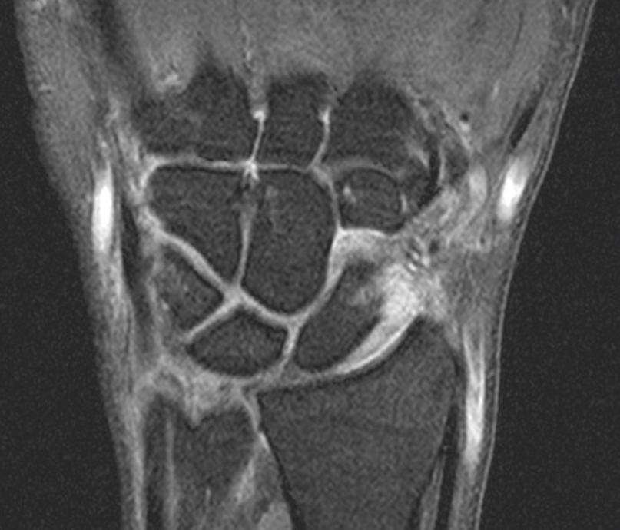
Peripheral Tear of the TFCC

Slide 61
Volar Extrinsic Ligaments
Radioscaphocapitate
Radiolunotriquetral
Batenni et al

Slide 62
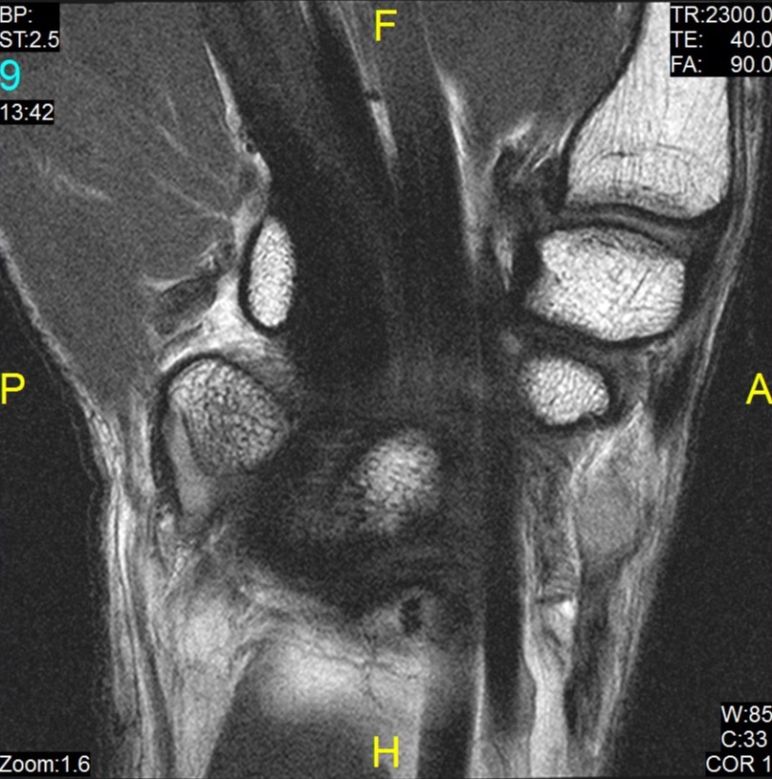
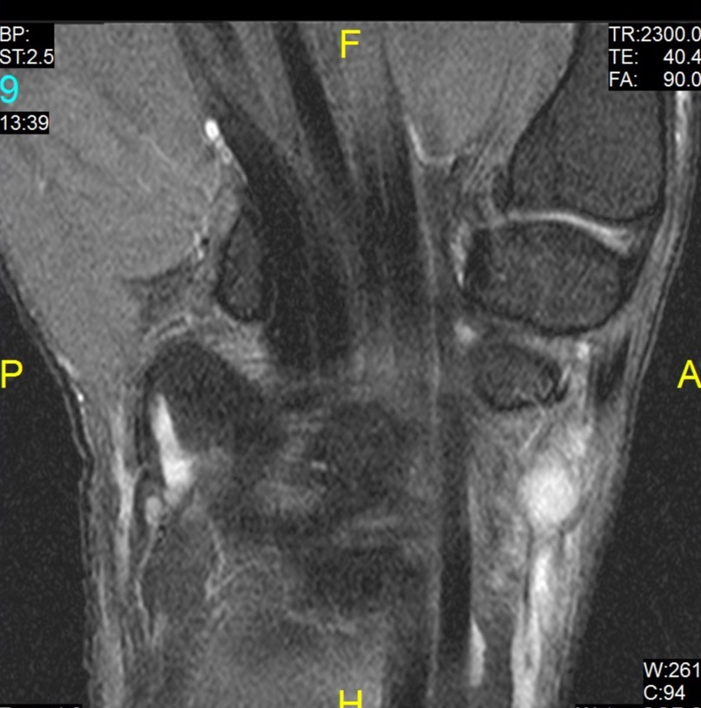
Volar Extrinsic Ligaments
Radiolunotriquetral
Radiolunotriquetral

Slide 63
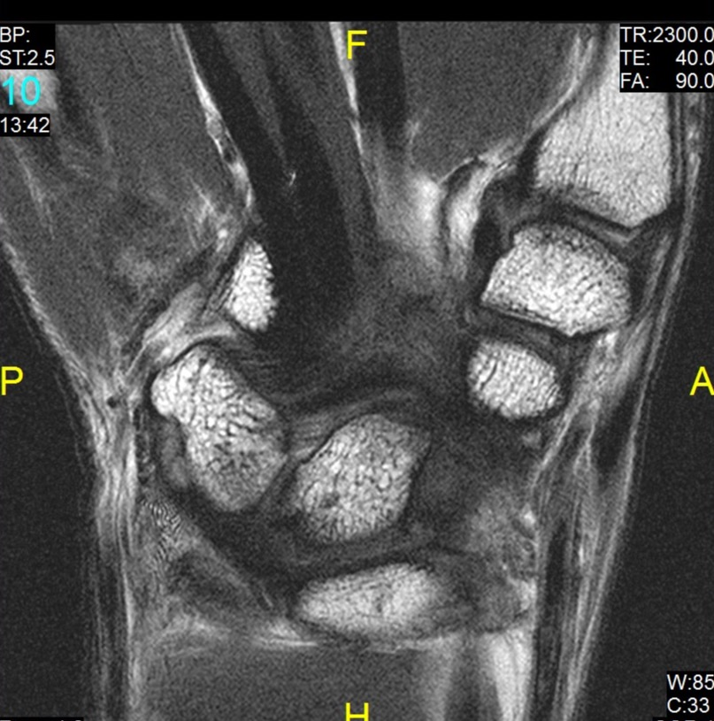
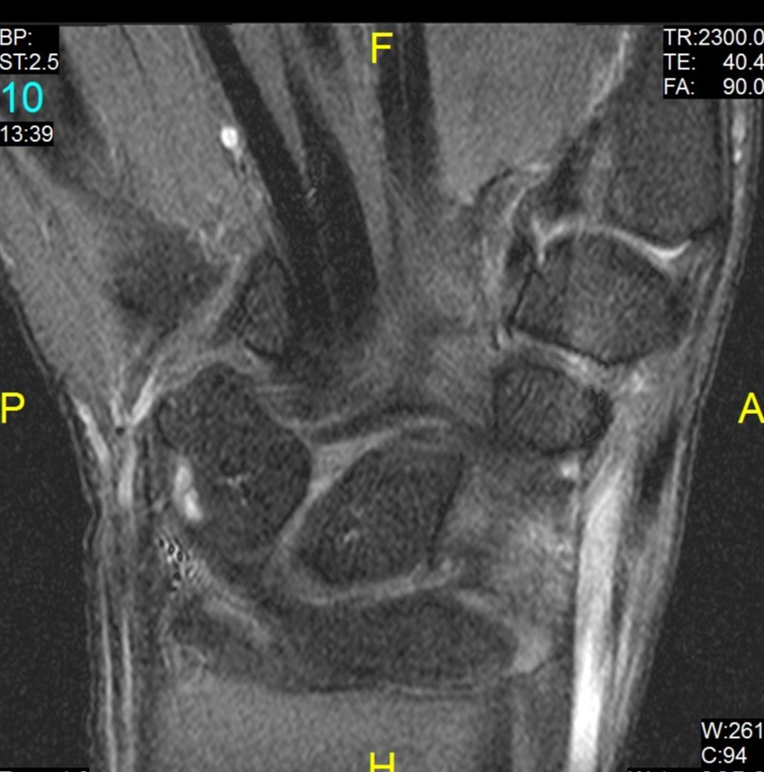
Volar Extrinsic Ligaments
Radioscaphocapitate
Radioscaphocapitate

Slide 64
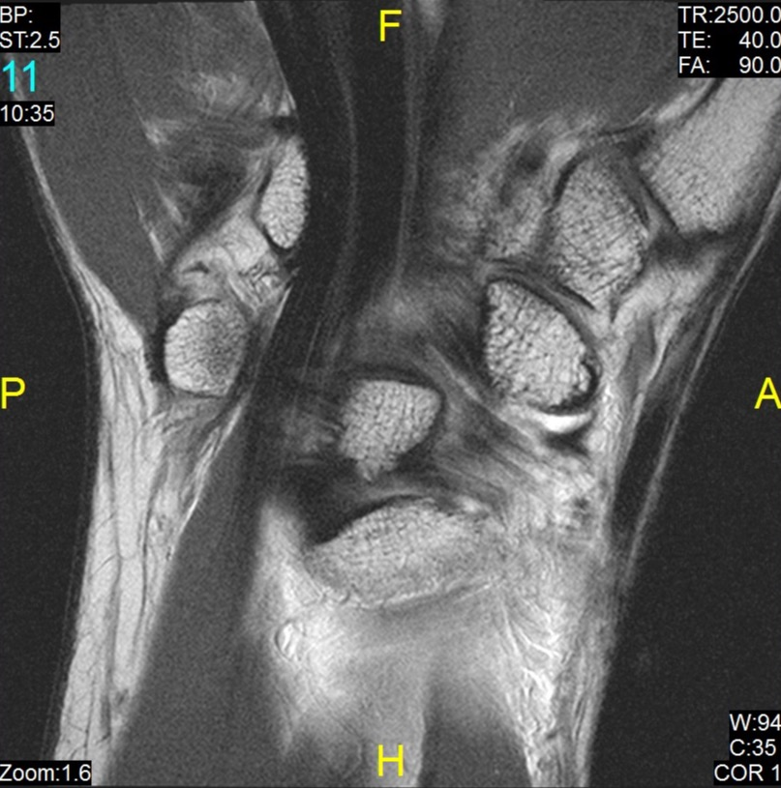
Volar Extrinsic Ligaments – Arthrogram
Radioscaphocapitate
Radiolunotriquetral

Slide 65
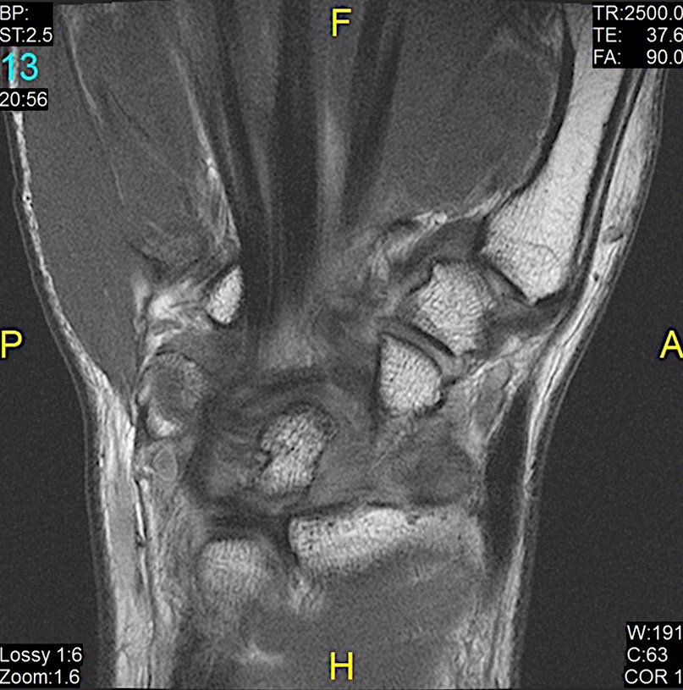
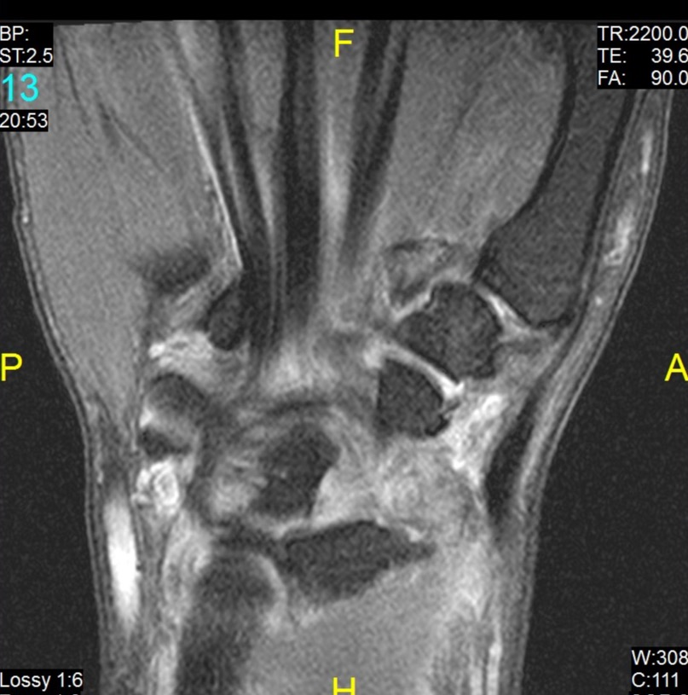
Injury of Radioscaphocapitate and Radiolunotriquetral Ligaments

Slide 66
Dorsal Extrinsic Ligaments
Intercarpal
Radiotriquetral
Radioulnar
Batenni et al

Slide 67
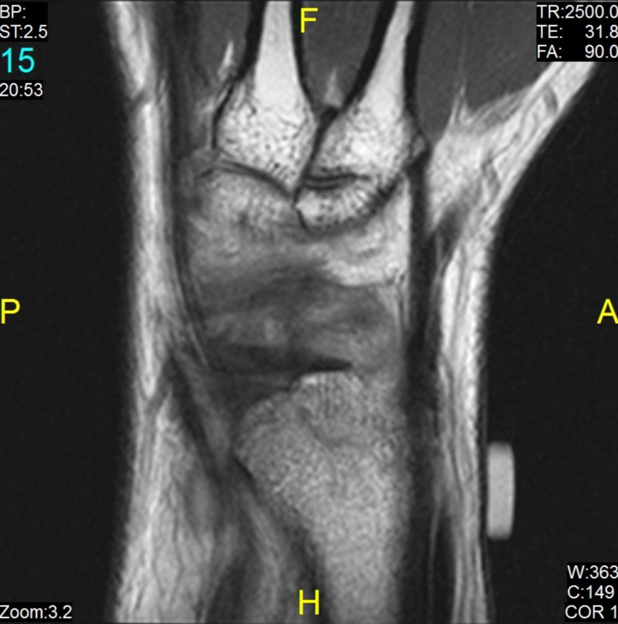
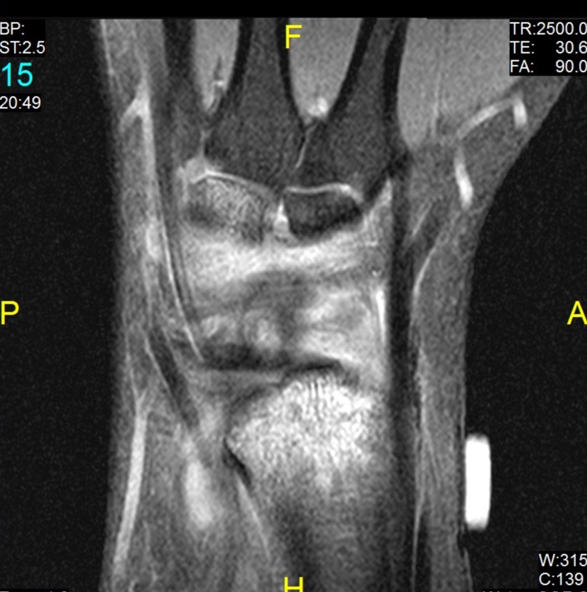
Dorsal Extrinsic Ligaments
Intercarpal
Intercarpal
Dorsal Radiotriquetral
Dorsal Radiotriquetral

Slide 68
Summary
Detailed knowledge of anatomy important as is normal variants and artifact
CT
Needs arthrography
MRI needs appropriate protocol
Technical factors can result in false negative/positive
Pick correct protocol – maximize signal and resolution and minimize noise and artifacts

Slide 69
Questions?

Slide 70
Thank You

Slide 71
A copy of the presentation can be found at:
eastriverimaging.com/blog/lenox-hill-wrist/

